Slide 1



NYSE: DHX
Q1 2026 Investor Presentation
June 4, 2026
Noble Emerging Growth Conference

Slide 2
Forward looking statements
This presentation and oral statements made from time to time by our representatives contain forward-looking statements within the meaning of the Private Securities Litigation Reform Act of 1995, Section 27A of the Securities Act of 1933, as amended, and Section 21E of the Securities Exchange Act of 1934, as amended. You should not place undue reliance on those statements because they are subject to numerous uncertainties and factors relating to our operations and business environment, all of which are difficult to predict and many of which are beyond our control. Forward-looking statements include, without limitation, information concerning our possible or assumed future financial condition, liquidity and results of operations, including expectations (financial or otherwise), our strategy, plans, objectives, and intentions, growth potential, and statements regarding our financial outlook. These statements often include words such as “may,” “will,” “should,” “believe,” “expect,” “anticipate,” “intend,” “plan,” “estimate,” "target" or similar expressions. These statements are based on assumptions that we have made in light of our experience in the industry as well as our perceptions of historical trends, current conditions, expected future developments and other factors we believe are appropriate under the circumstances. Although we believe that these forward-looking statements are based on reasonable assumptions, you should be aware that many factors could affect our actual financial results or results of operations and could cause actual results to differ materially from those in the forward-looking statements. These factors include, but are not limited to, our ability to execute our tech-focused strategy, a write-off of all or a part of our goodwill and intangible assets, backlog not accurately representing future revenue, competition from existing and future competitors in the highly competitive markets in which we operate, failure to adapt our business model to keep pace with rapid changes in the recruiting and career services business and the development of new products and services, macroeconomic conditions, including government shutdowns, the impact of initiatives to restructuring or streamlining government agencies, such as DOGE, the risk that AI models will reduce demand for technology professionals in the workforce, failure to maintain and develop our reputation and brand recognition, failure to increase or maintain the number of customers who purchase recruitment packages, failure to attract qualified professionals to our websites or grow the number of qualified professionals who use our websites, inability to successfully integrate future acquisitions or identify and consummate future acquisitions, misappropriation or misuse of our intellectual property, claims against us for intellectual property infringement or failure to enforce our ownership of intellectual property, failure to attract and retain users who create and post original content on our web properties, taxation risks in various jurisdictions and the potential for unfavorable decisions related to tax assessments, taxation risks impacting our liability or past sales, and ability to make future sales, downturns in our customers' businesses, our indebtedness and our ability to borrow funds under our
revolving credit facility or refinance our indebtedness, restrictions on our current and future operations under such indebtedness, development and use of artificial intelligence, failure to scale, adapt and maintain our restrictions on our current and future operations under such indebtedness, development and use of artificial intelligence, failure to timely and efficiently scale, adapt and maintain our technology and infrastructure, capacity constraints, systems failures or breaches of network security, usefulness of our candidate profiles to our customers, decreases in our user engagement, changes in search engines’ methodologies, failure to halt operations of third-party websites aggregating our data, reliance on third-party hosting facilities, our compliance with laws and regulations, U.S. and foreign government regulation of the Internet and taxation, failure to attract or retain key executives and personnel, our ability to navigate the cyclicality or downturns of the U.S. and worldwide economies, litigation related to infringement or other claims regarding our services or content, our ability to defend ownership of our intellectual property, global climate change, compliance with the continued listing standards of the New York Stock Exchange, volatility in our stock price, differences between estimates of financial projections and future results, failure to maintain internal controls over financial reporting, results of operations fluctuating on a quarterly and annual basis, our rights plan may have anti-takeover effects, anti-takeover provisions in our governing documents making changes to management difficult, and disruption resulting from unsolicited offers to purchase the company. These factors and others are discussed in more detail in the Company’s filings with the Securities and Exchange Commission, all of which are available on the Investors page of our website at www.dhigroupinc.com, including the Company’s most recently filed reports on Form 10-K and Form 10-Q and subsequent filings under the headings “Risk Factors,” “Forward-Looking Statements” and “Management’s Discussion and Analysis of Financial Condition and Results of Operations.” You should keep in mind that any forward-looking statement made by the Company or its representatives herein, or elsewhere, speaks only as of the date on which it is made. New risks and uncertainties come up from time to time, and it is impossible to predict these events or how they may affect us. We have no obligation to update any forward-looking statements after the date hereof, except as required by applicable federal securities laws.

Slide 3


Listed
HQ
Year End
Diluted Shares Outstanding (Q4 2025)
NYSE:
DHX (2007)
Denver, CO
Est. 1990
December 31
45M

Slide 4

DHI Group owns ClearanceJobs and Dice, which are platforms for finding and engaging with top tech talent, including engineers, software developers, data scientists, cybersecurity experts, professionals with AI skills and more. With over 9 million tech professional profiles on our two platforms, we use AI-powered tools and our proprietary skills algorithm to connect employers with the most qualified candidates for their job openings.

Slide 5








DHI Group: Two-Sided Marketplaces
Tech
Professional
Candidates
Companies and Recruiters
7.8M Tech Professionals
2M Tech candidates with Security Clearances
Help Companies and Recruiters Attract, Engage and Hire Tech Talent
Two Online Recruiting Platforms with proprietary software technology
SaaS Business Model with approximately 90% Recurring Revenue
Millions of Candidate Profiles due to the Longevity of the Platforms

Slide 6

DHI Offers Candidates that Cannot be Found Elsewhere
  Many active Dice tech professionals are not found on generalist sites like ZipRecruiter, Indeed or LinkedIn.​​
  In cases where competitors do have overlapping candidate profiles, the majority are outdated by at least 6 months. ​​
  LinkedIn has no profile field for government clearance​
  Government workers and contractors have freedom to use ClearanceJobs due to the lack of hostile actors on the platform​​
  Other smaller competitors are a fraction the size of ClearanceJobs

Slide 7

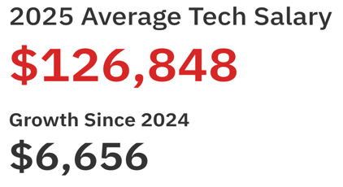


Compelling ROI for Companies
“Dice has paid for itself already as we made one hire that we could not find anywhere else.”
American National Insurance
Tech Professionals are
very expensive.
Most recruiters charge between
20-25% of the first-year salary of a candidate they place.
Dice and CJ charge between $8-$10k for a standard entry level license for clients. The ROI of making one placement using these platforms is high.

Slide 8

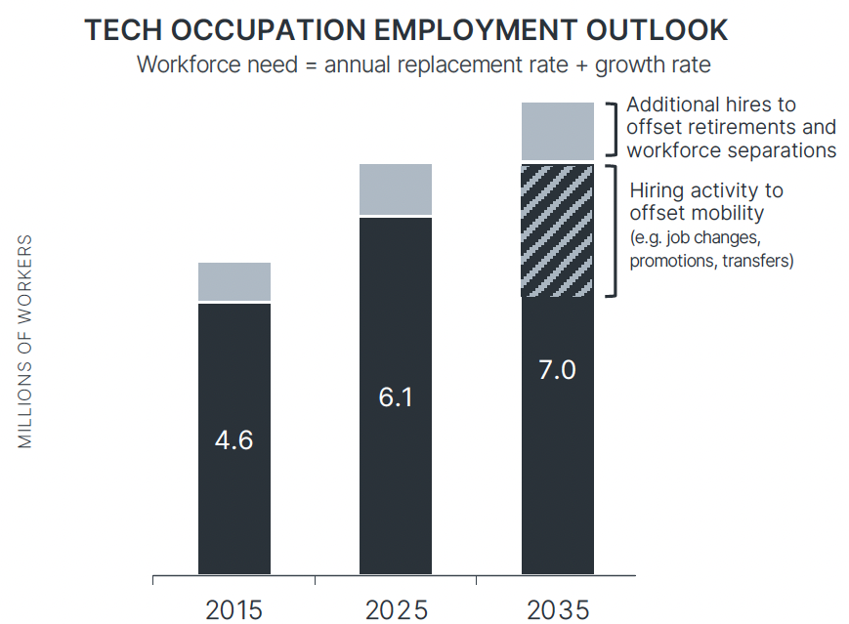
Tech Workforce Growth
Over the next ten years, the tech workforce is projected to grow twice as fast as the overall U.S. workforce¹.
Projected tech growth rates above the national rate²:
2
414% | Data Scientists and Data Analysts
367% | Cybersecurity Analysts and Engineers
297% | Software Developers and Engineers
220% | Software QA and Testers
186% | Web Designers and UI/UX
164% | CIOs, IT Directors and Manager
152% | Web Developers
99% | Emerging Tech, IT Project Mgt., Other
81% | Database Architects
81% | Systems Analysts and Engineers
53% | Database Administrators
28% | Tech Support Specialists
The macro trend of digital transformation means demand for tech talent across the full spectrum of tech job roles.
The growth consists of an expected 43% average annual turnover rate and overall population gain
1. U.S. Bureau of Labor Statistics and Lightcast
2. CompTIA State of the Tech Workforce, 2025

Slide 9






Opportunity for ClearanceJobs and Dice
2025 Revenue
10,000+
$55M, +12% CAGR¹
Cleared employers
Growth opportunity
100+
Subscription clients
Cleared Professionals
Marketplace
1.7K
Government agencies
2025 Revenue
80,000+
$73M, -4% CAGR¹
Commercial accounts
Subscription clients
Growth opportunity
18,000
3.8K
Tech Candidate
Marketplace
Staffing, Recruiting, Consulting Firms
1 CAGR represents Compound Annual Growth Rate from 2021 to 2025

Slide 10






How do we make money?
Clients
Pay for Annual Subscription Contracts
Candidates
Don’t Pay to Create a Profile or Engage with Recruiters
Engagement
We strategically limit profile views and encourage connections
~90% annual recurring revenue
Adding Thousands of Candidates Each Month
Recruiters Chase Candidates

Slide 11

FINANCIAL PERFORMANCE

Slide 12
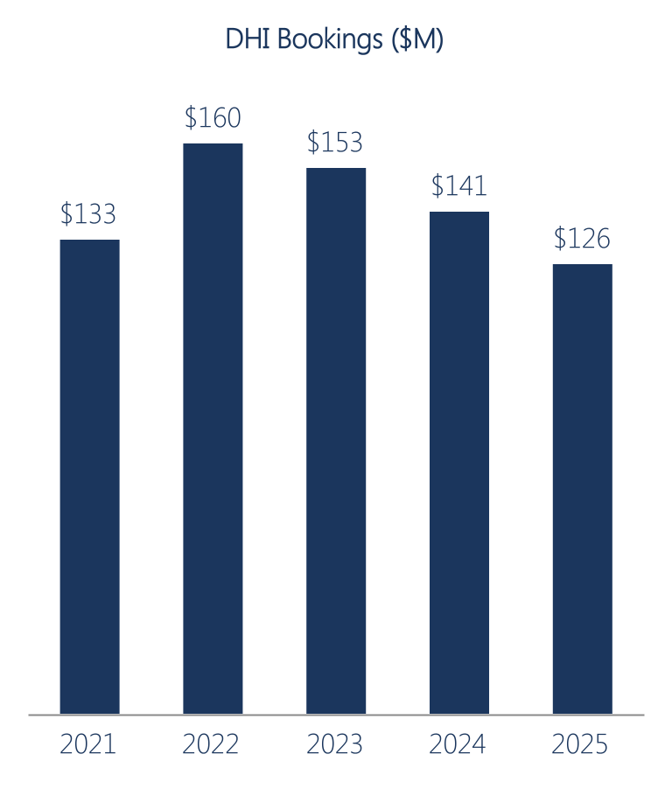
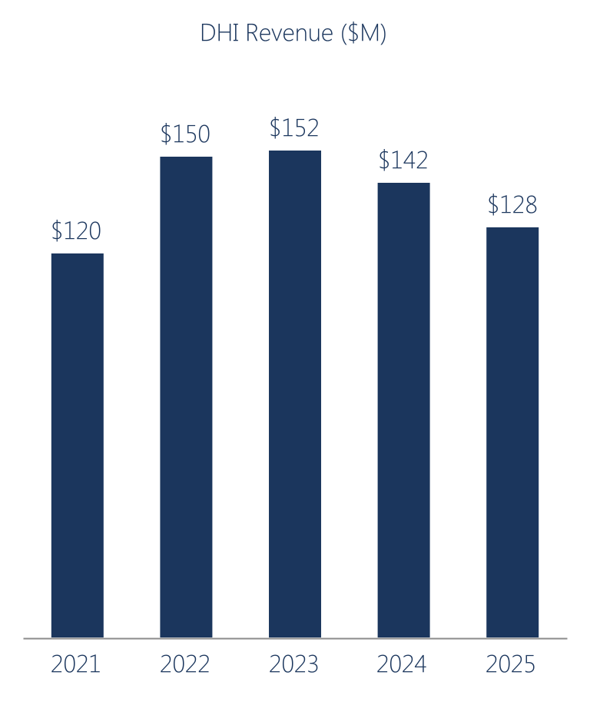
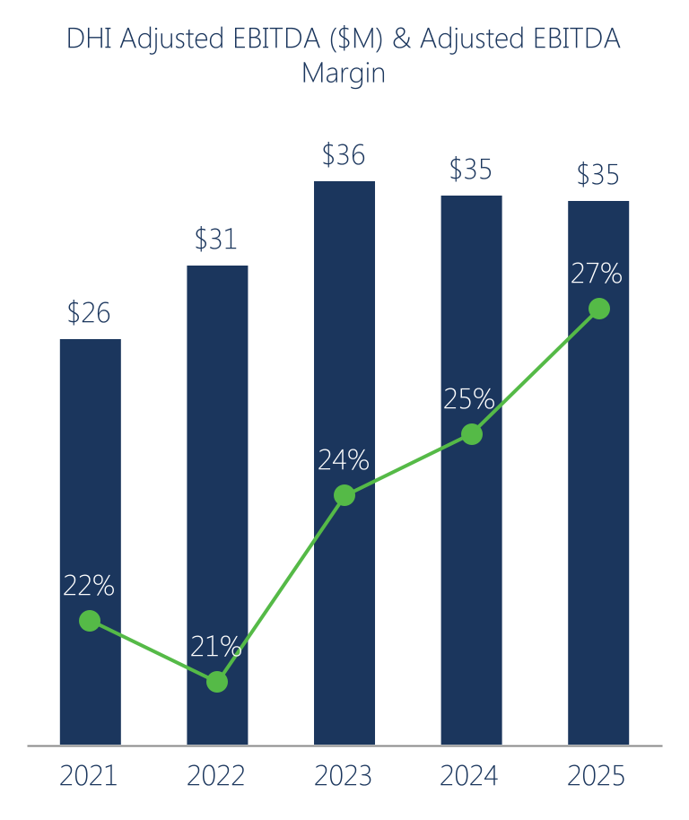
DHI Group Annual Financial Performance
2
2
2
-1% CAGR¹
2% CAGR¹
8% CAGR¹
1 CAGR represents Compound Annual Growth Rate, in dollars, from 2021 to 2025.
2 In June 2021, the Company transferred majority ownership and control of its eFinancialCareers (“eFC”) business to eFC’s management. Bookings, revenue and Adjusted EBITDA throughout this document exclude eFC.

Slide 13
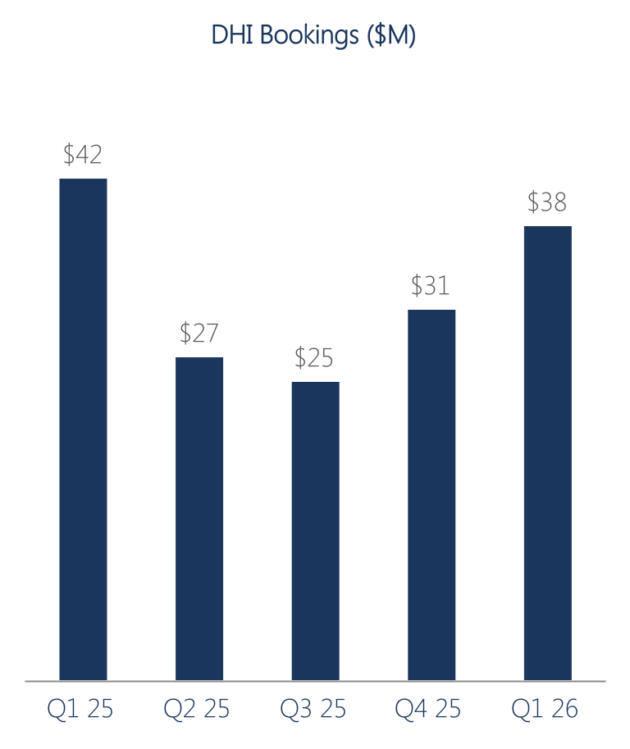
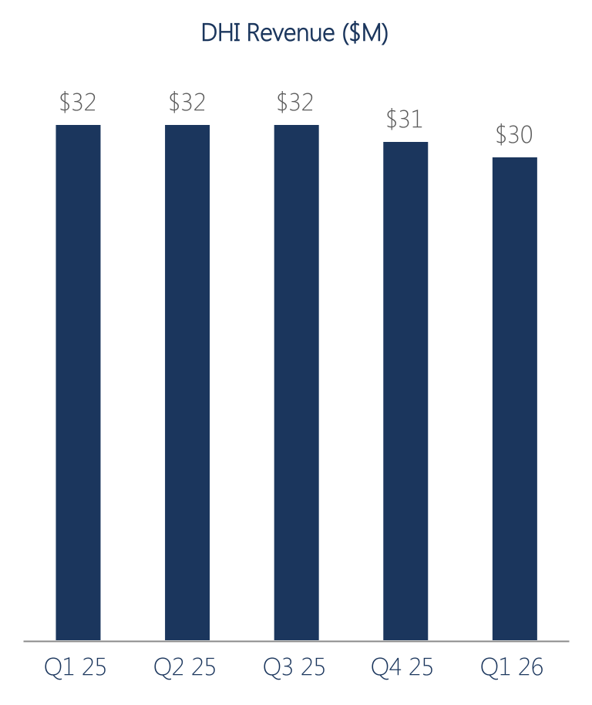
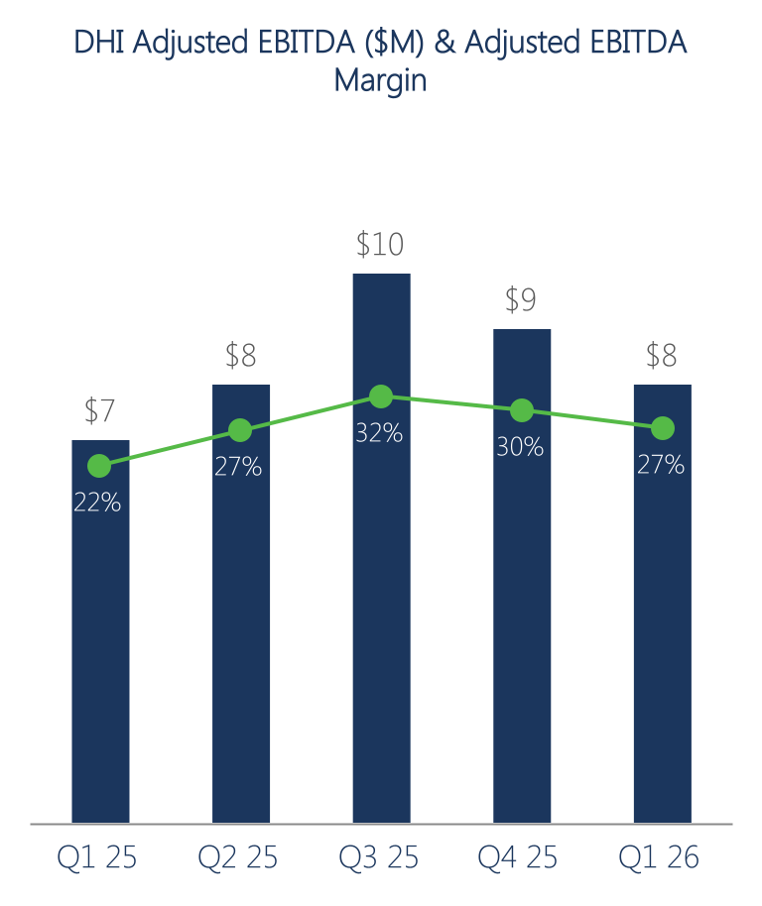
DHI Group Quarterly Financial Performance
10%
11%
9%
14%
10%
8%
9%
19%
2%
5%
5%
17%
10%
12%
19%
Percentages, other than Adjusted EBITDA Margin, reflect year-over-year performance changes.

Slide 14
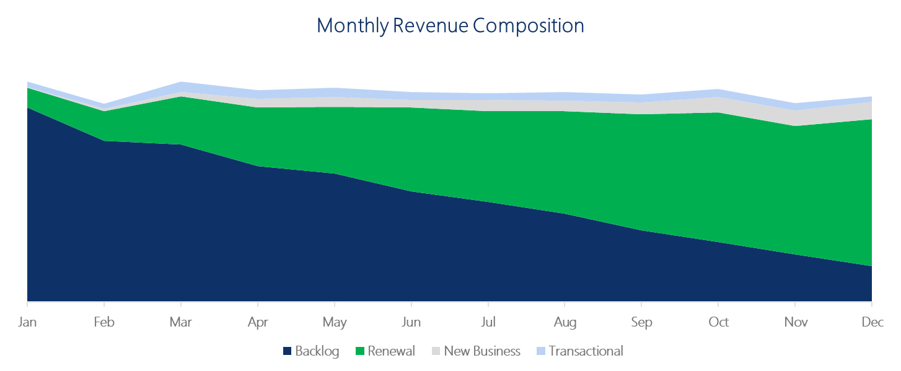
Revenue Stability: Recurring Revenue Model
With a subscription-based business, a large portion of revenue is contracted and booked at the beginning of each year with high predictability as we renew our contracts throughout the year.

Slide 15
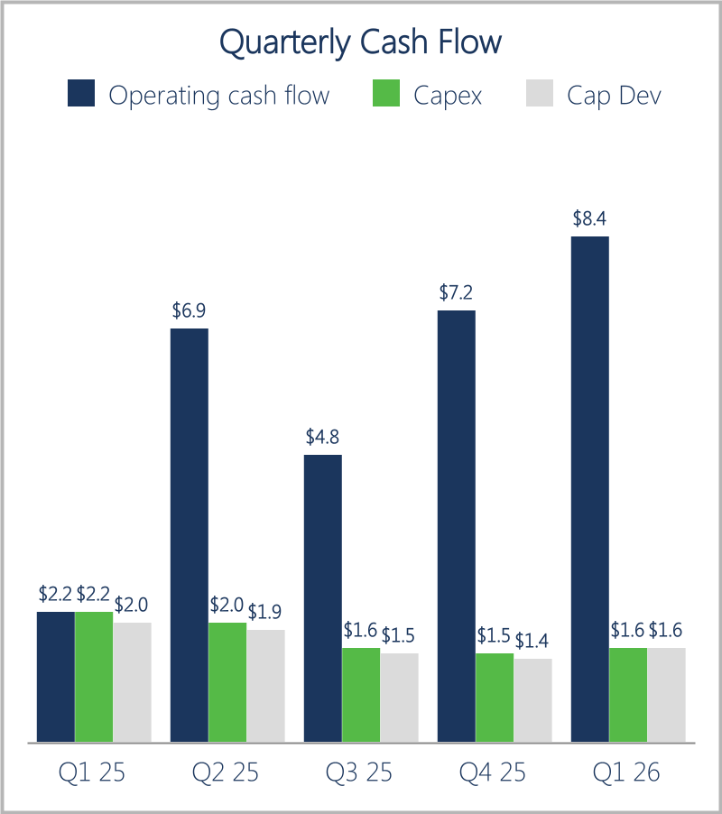
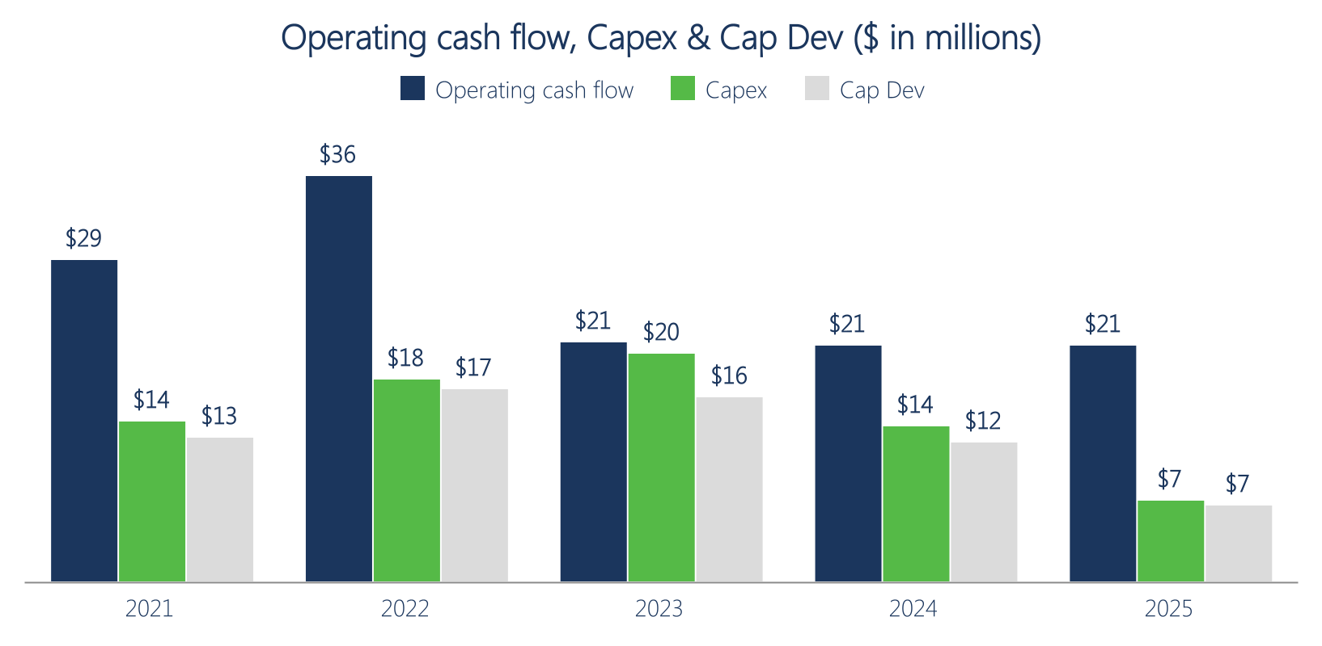
DHI Group Cash Flow
1
Operating cash flows in Q1 2026 were $8.4M
Capitalized development costs comprise over 90% of capex and cap dev is trending down
1 Cap Dev refers to capitalized development costs (cap dev) from both internal labor and external vendors incurred from building new products and features on the Company's platforms. Cap dev is included in capex.

Slide 16
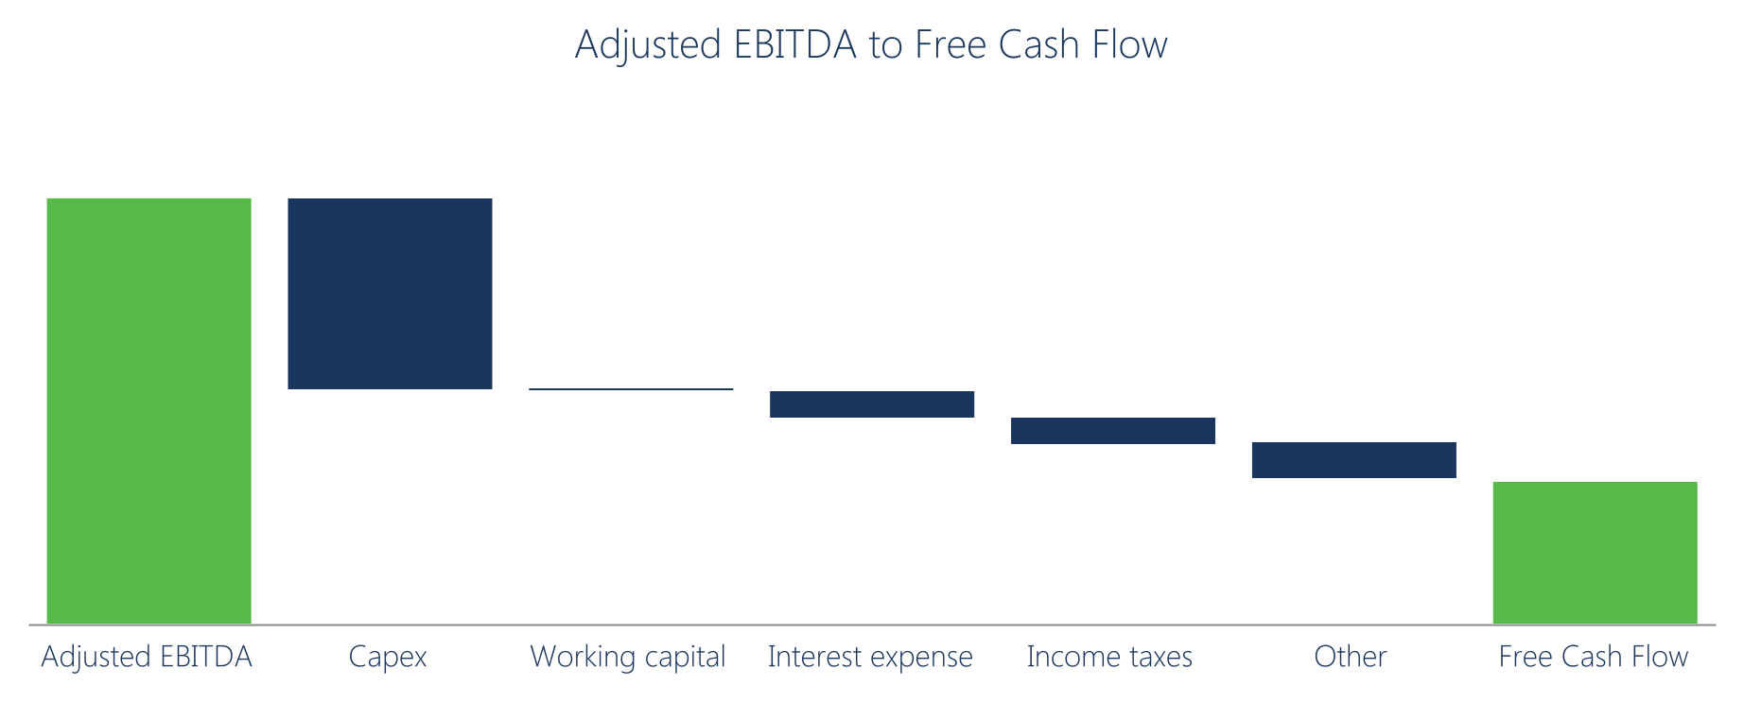
Illustration of DHI Group Free Cash Flow
1
2
Long term goal to deliver free cash flow at or above 10% of revenue
DHI Group Free Cash Flow Sources/ Uses composed of multiple elements, with Capex being the primary driver Reduced capitalized development costs resulted in $6.6 million lower capex spend in 2025
  Each component calculated using the five-year average (2021 to 2025)
  Working capital excludes the impact of income taxes

Slide 17
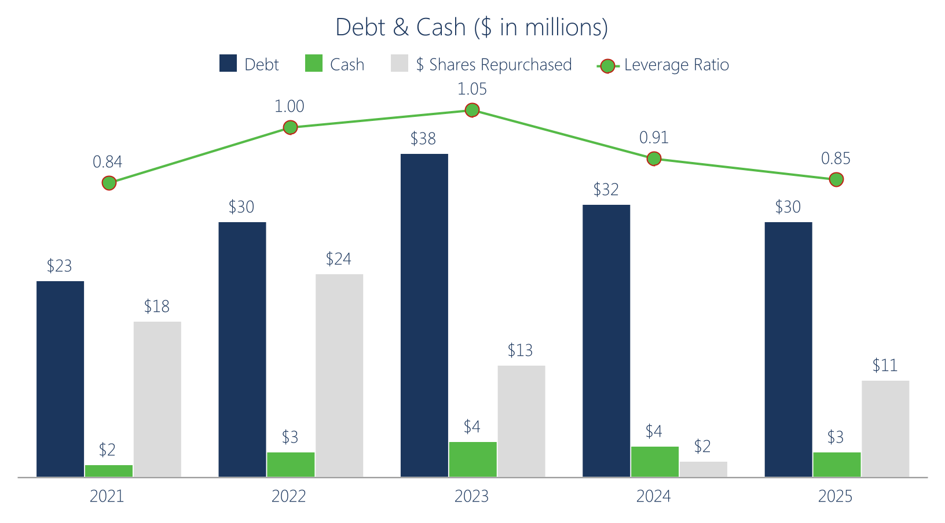
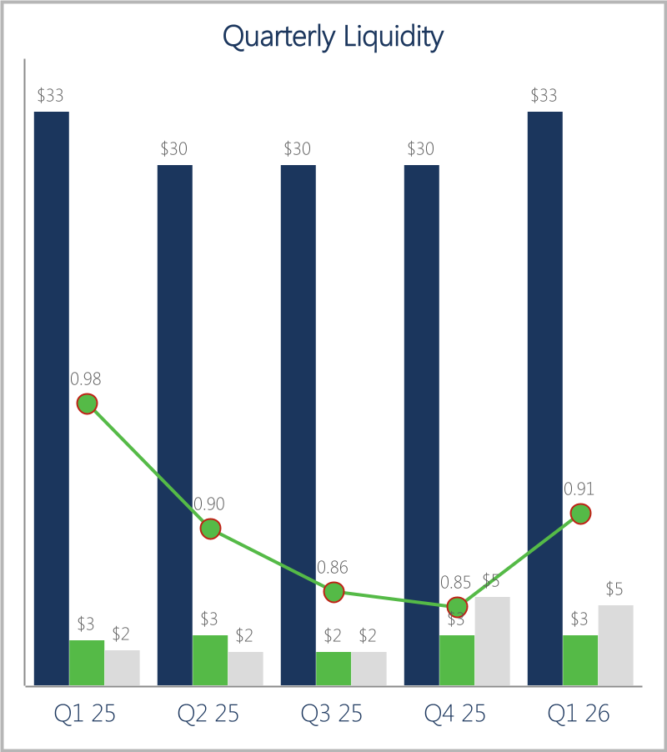
DHI Group Liquidity
1
2
Q1 2026 cash of $3M, debt of $33M, leverage ratio of 0.91
20M shares repurchased for $73M since 2021
1. Includes shares repurchased under an approved stock repurchase plan and shares repurchased pursuant to our equity award plan as shares withheld for employee taxes from the vesting of employee restricted stock or performance-based restricted stock units.
2. Leverage Ratio is computed by dividing debt by Adjusted EBITDA.

Slide 18
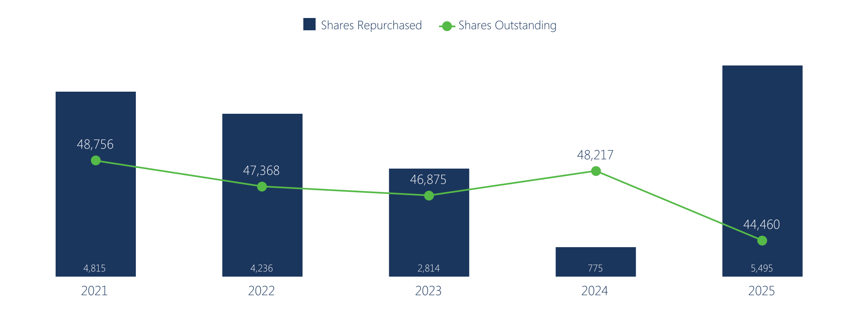
DHI Group Buyback History
Shares Outstanding and Share Repurchases¹ (shares in thousands)
Shares count down 4.3M shares, of 9%, since 2021
$10M stock repurchase plan in place through February 2027
Shares repurchased outpacing equity grants to employees and directors, offsetting dilution
1 Includes shares repurchased under an approved stock repurchase plan and shares repurchased pursuant to our equity award plan as shares withheld for employee taxes from the vesting of employee restricted stock or performance-based restricted stock units.

Slide 19
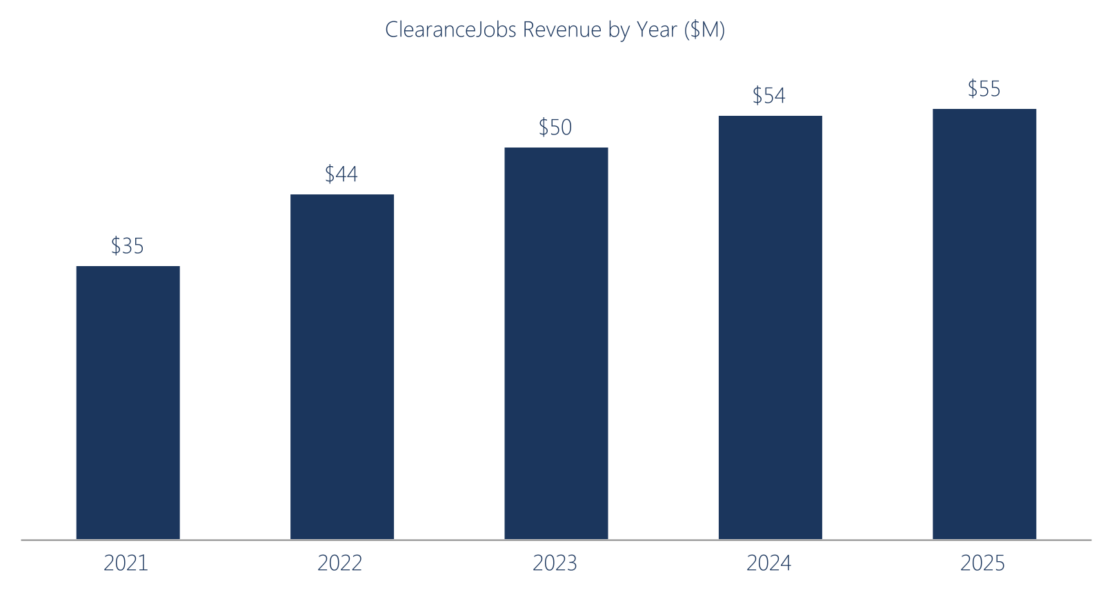
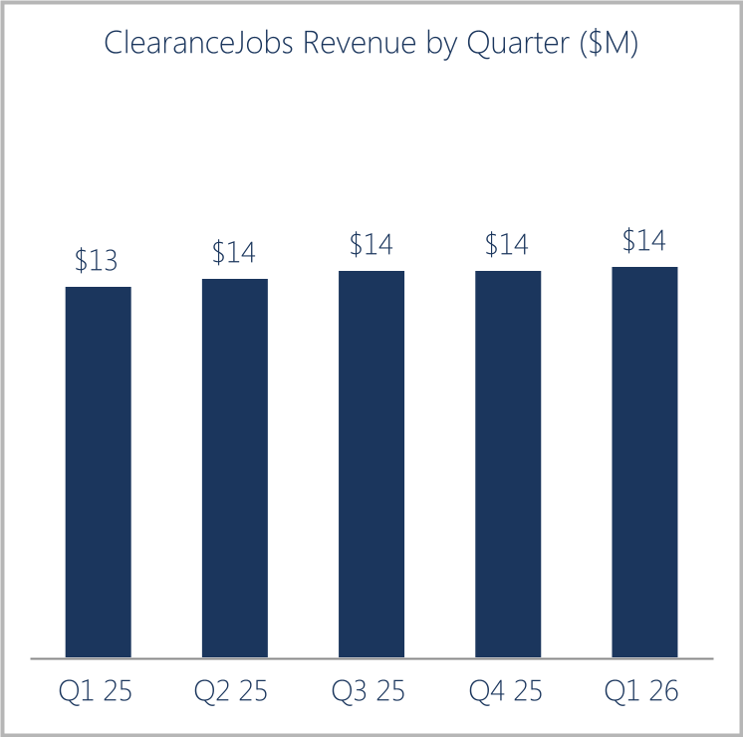
ClearanceJobs Revenue
12% CAGR¹
2
3%
1%
1%
1%
5%
ClearanceJobs revenue CAGR 12%
ClearanceJobs revenue up +5% YoY in Q1 2026
1 CAGR represents Compound Annual Growth Rate from 2021 to 2025.
2 Percentage represents the change versus the prior year quarter.

Slide 20
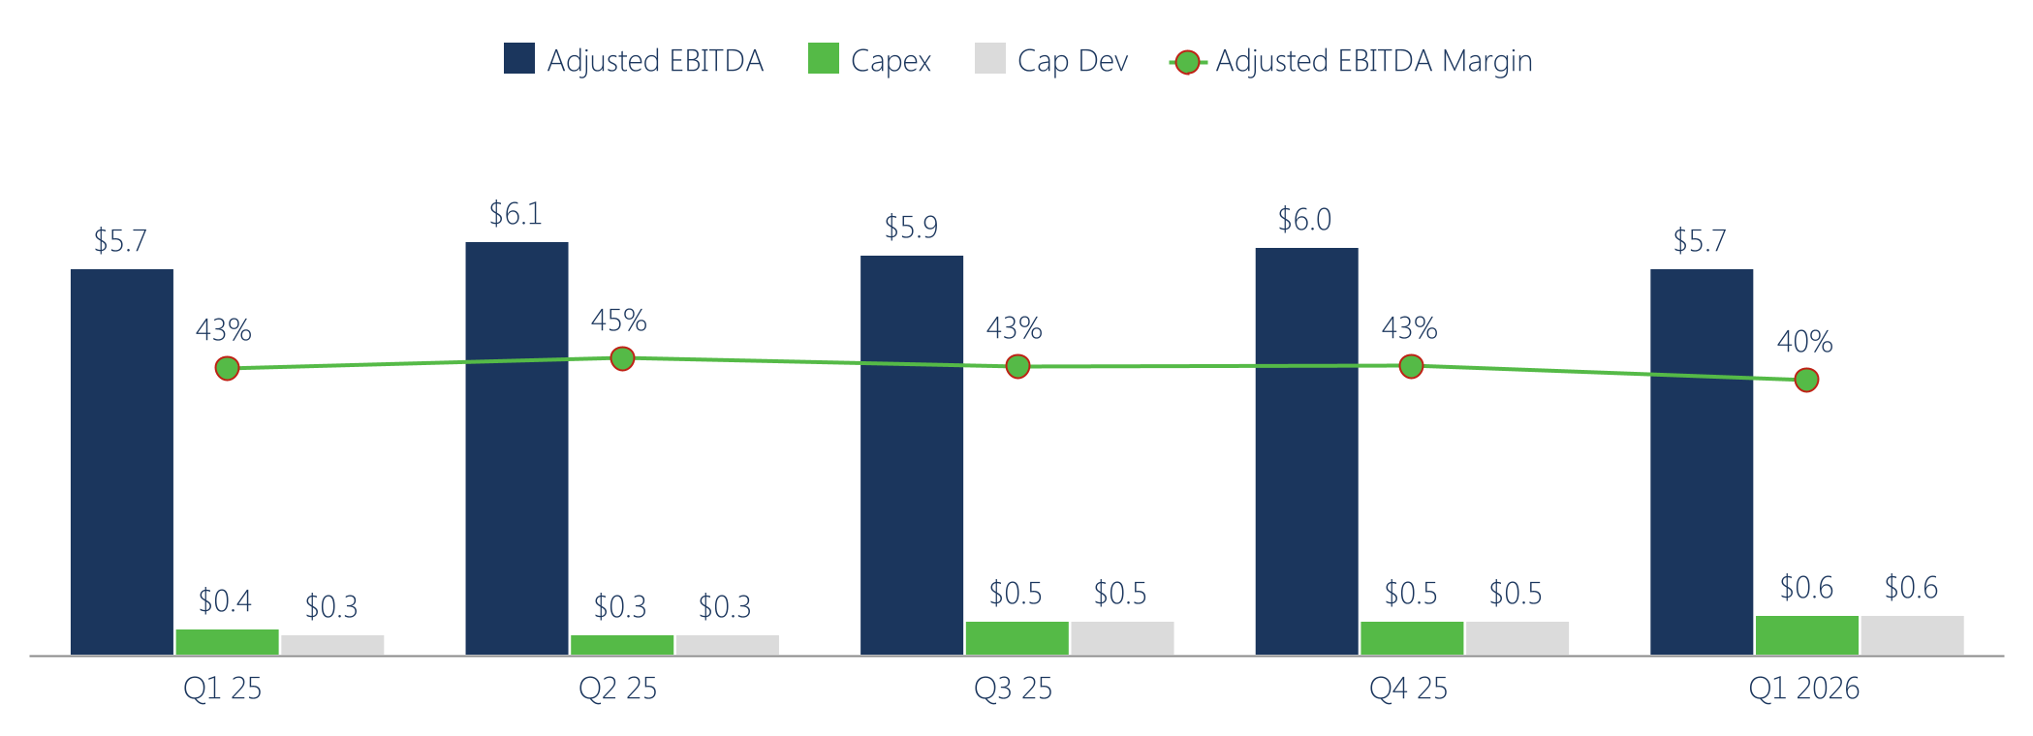
ClearanceJobs Adjusted EBITDA and Capex
Adjusted EBITDA and Capital Expenditures ($ in millions)
Q1 2026 Adjusted EBITDA at $5.7M, a margin of 40%.
Strong Adjusted EBITDA conversion to cash with low cap dev.
Capex primarily consists of cap dev.

Slide 21
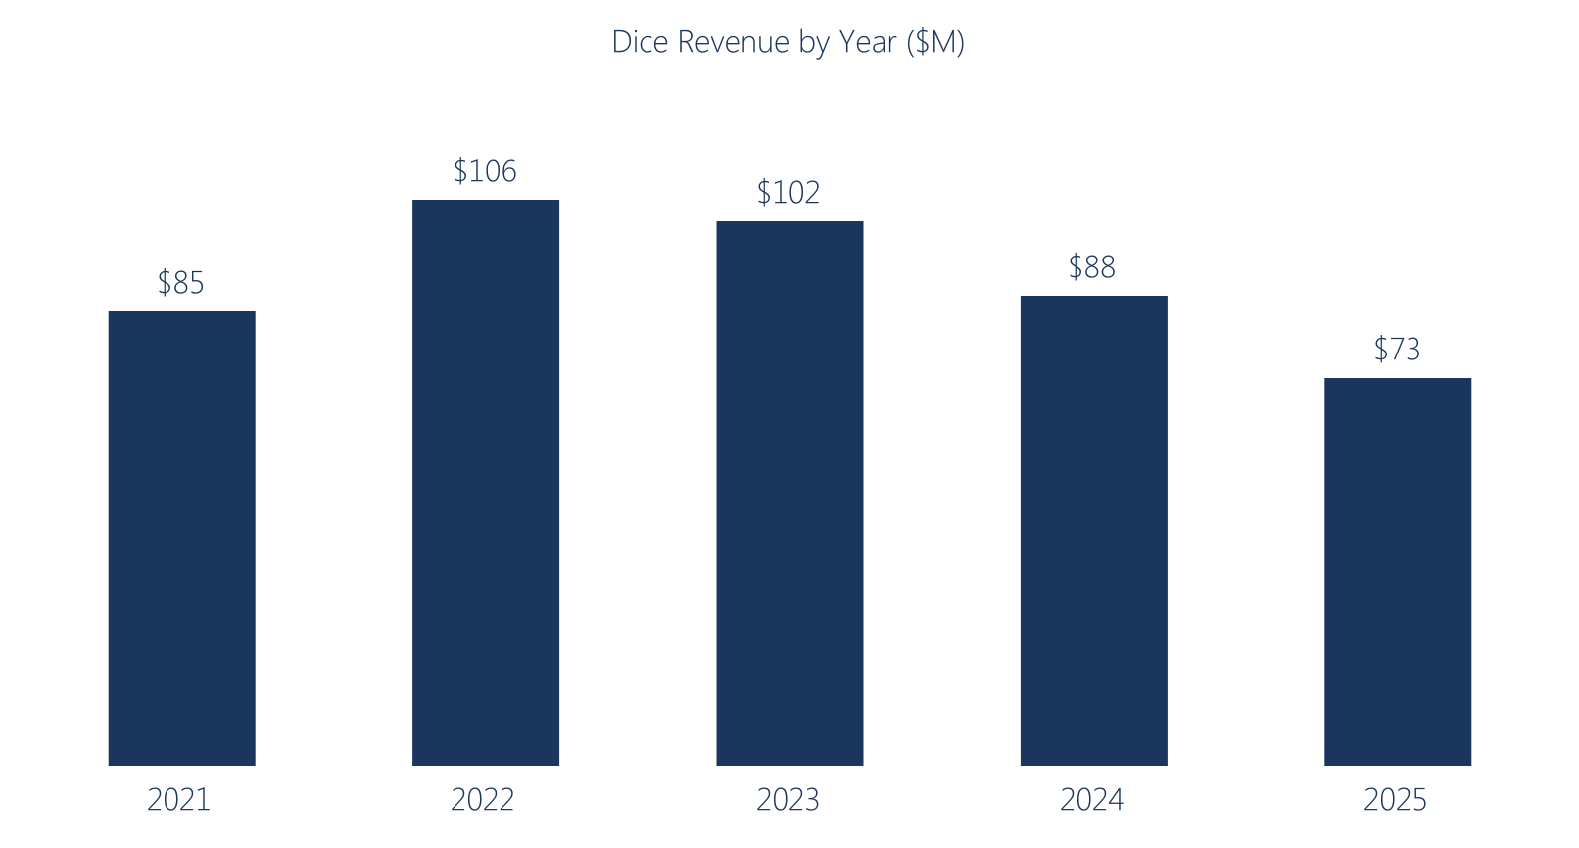
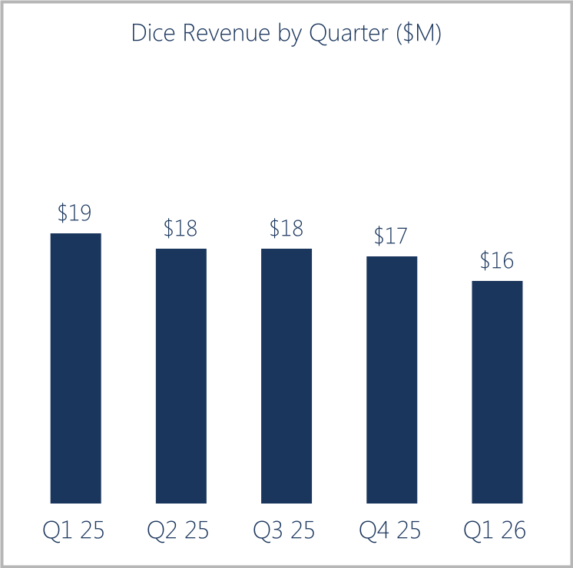
Dice Revenue
-4% CAGR¹
2
18%
18%
15%
17%
17%
Dice Revenue CAGR -4%
Dice revenue down -17% YoY in Q1 2026
1 CAGR represents Compound Annual Growth Rate from 2021 to 2025.
2 Percentage represents the change versus the prior year quarter.

Slide 22
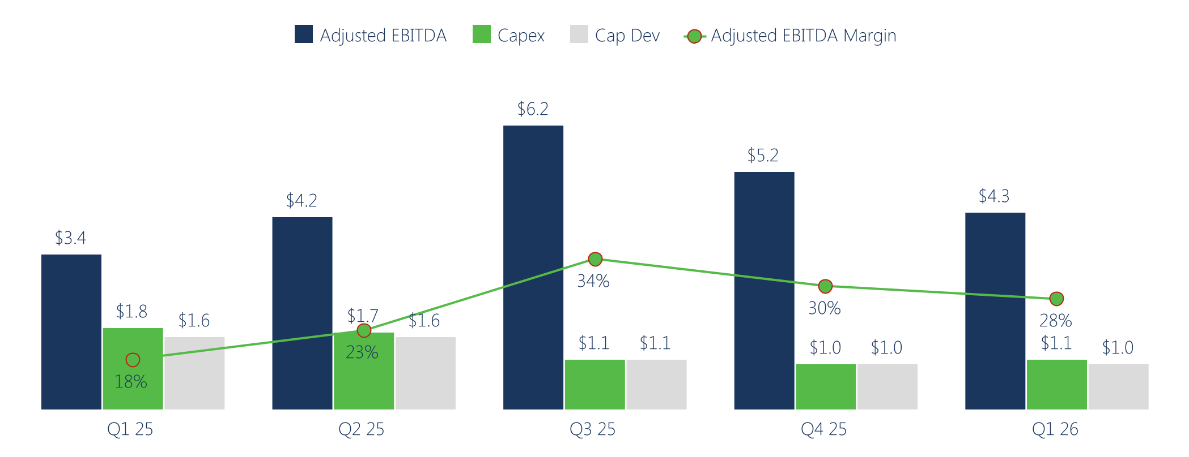
Dice Adjusted EBITDA and Capex
Adjusted EBITDA and Capital Expenditures ($ in millions)
Q1 2026 Adjusted EBITDA of $4.3M, a margin of 28%.
Capex primarily consists of cap dev.

Slide 23

Why Buy DHX Stock*
  Poised for growth from global defense spending and need for specialized tech talent
  Committed to expand CJ monetization opportunities
  Strong Adjusted EBITDA margin and free cash flow allow us to invest and maintain our share buyback program
On January 28, 2025, the Company announced that it entered into a Section 382 Rights Agreement (the “Agreement”) to facilitate the Company’s ability to preserve its capital loss carryforwards and its other tax attributes. The Agreement generally deters the purchase of more than 4.99% of the Company’s stock.

Slide 24
Appendix

Slide 25
DHI Group, Inc.
Supplemental data - customer data (unaudited)
ClearanceJobs | Q1 2023 | Q2 2023 | Q3 2023 | Q4 2023 | Q1 2024 | Q2 2024 | Q3 2024 | Q4 2024 | Q1 2025 | Q2 2025 | Q3 2025 | Q4 2025 | Q1 2026
Bookings¹ ²(in millions) | $ 16.2 | $ 10.7 | $ 12.3 | $ 14.2 | $ 17.0 | $ 11.5 | $ 12.8 | $ 14.2 | $ 16.8 | $ 11.6 | $ 12.0 | $ 14.6 | $ 18.0
Revenues¹ (in millions) | $ 11.9 | $ 12.7 | $ 12.9 | $ 12.9 | $ 13.0 | $ 13.5 | $ 13.8 | $ 13.8 | $ 18.9 | $ 13.6 | $ 13.9 | $ 13.9 | $ 14.0
Recruitment Package Customers | 2,078 | 2,069 | 2,054 | 2,055 | 2,032 | 2,009 | 1,982 | 1,949 | 1,891 | 1,868 | 1,822 | 1,775 | 1,741
Average Annual Revenue Per Recruitment Package Customer³ | $ 20,520 | $ 20,842 | $ 21,422 | $ 21,872 | $ 23,050 | $ 24,275 | $ 24,762 | $ 25,148 | $ 25,806 | $ 26,026 | $ 26,601 | $ 27,246 | $ 27,286
Revenue Renewal Rate | 95 % | 90 % | 94 % | 96 % | 98 % | 96 % | 91 % | 93 % | 92 % | 87 % | 85 % | 90 % | 88 %
Customer Renewal Rate | 83 % | 81 % | 81 % | 78 % | 78 % | 78 % | 78 % | 76 % | 79 % | 77 % | 76 % | 72 % | 71 %
Retention Rate⁴ | 109 % | 110 % | 112 % | 110 % | 115 % | 113 % | 109 % | 111 % | 106 % | 103 % | 106 % | 109 % | 105 %
Dice | Q1 2023 | Q2 2023 | Q3 2023 | Q4 2023 | Q1 2024 | Q2 2024 | Q3 2024 | Q4 2024 | Q1 2025 | Q2 2025 | Q3 2025 | Q4 2025 | Q1 2026
Bookings¹ ² (in millions) | $ 37.4 | $ 21.6 | $ 18.9 | $ 21.8 | $ 31.8 | $ 18.5 | $ 16.1 | $ 18.7 | $ 25.3 | $ 15.6 | $ 13.4 | $ 16.6 | $ 20.2
Revenues¹ (in millions) | $ 26.7 | $ 25.8 | $ 24.6 | $ 24.4 | $ 23.0 | $ 22.3 | $ 21.4 | $ 21.0 | $ 13.4 | $ 18.4 | $ 18.2 | $ 17.4 | $ 15.7
Recruitment Package Customers | 6,171 | 6,007 | 5,752 | 5,492 | 5,250 | 5,031 | 4,868 | 4,711 | 4,490 | 4,365 | 4,239 | 4,132 | 3,832
Average Annual Revenue Per Recruitment Package Customer³ | $ 15,672 | $ 15,534 | $ 15,531 | $ 15,788 | $ 15,997 | $ 16,294 | $ 16,330 | $ 16,380 | $ 16,384 | $ 15,434 | $ 15,727 | $ 15,635 | $ 15,466
Revenue Renewal Rate | 92 % | 84 % | 78 % | 78 % | 82 % | 78 % | 74 % | 77 % | 70 % | 75 % | 69 % | 78 % | 71 %
Customer Renewal Rate | 82 % | 79 % | 73 % | 71 % | 74 % | 69 % | 69 % | 69 % | 69 % | 66 % | 68 % | 69 % | 59 %
Retention Rate⁴ | 105 % | 101 % | 99 % | 97 % | 100 % | 99 % | 96 % | 97 % | 92 % | 102 % | 92 % | 94 % | 100 %
1 We had previously disclosed that career events were recorded within Dice. Career events have been reclassified between ClearanceJobs and Dice based on the nature of the event for all periods presented
2 Bookings represent the value of all contractually committed services in which the contract start date is during the period and will be recognized as revenue within 12 months of the contract start date. For contracts that extend beyond 12 months, the value of those contracts beyond 12 months is recognized as bookings on each annual anniversary of each contract start date valued as the amount of revenue that will be recognized within 12 months of the respective anniversary date.
3 Calculated by dividing recruitment package customer revenue by the daily average count of recruitment package customers during each month, adjusted to reflect a thirty-day month. The simple average of each month is used to derive the amount for each period and then annualized to reflect twelve months.
4 For customers that renewed their annual recruitment packages during the period, the retention rate represents the total contract value renewed, relative to the previous total contract value.

Slide 26
DHI Group, Inc.
Supplemental data – Historical Activity (unaudited)
(dollars in millions)
DHI Group, Inc. | Q1 25 | Q2 25 | Q3 25 | Q4 25 | FY 2025 | Q1 26
Revenues | $32.3 | $32.0 | $32.1 | $31.4 | $127.8 | $29.7
Cost of revenues | 5.3 | 5.1 | 4.6 | 4.5 | 19.5 | 4.7
Product development | 3.8 | 3.1 | 2.9 | 3.0 | 12.8 | 3.0
Sales | 6.4 | 6.2 | 5.1 | 5.3 | 23.0 | 5.2
Marketing | 4.7 | 4.3 | 4.0 | 3.8 | 16.8 | 3.8
General & administrative | 5.1 | 4.7 | 5.3 | 5.4 | 20.5 | 4.8
Total operating expenses | 25.3 | 23.4 | 21.9 | 22.0 | 92.6 | 21.5
Adjusted EBITDA | 7.0 | 8.5 | 10.3 | 9.4 | 35.1 | 8.1
Adjusted EBITDA Margin | 22% | 27% | 32% | 30% | 27% | 27%
Capitalized Development | 2.0 | 1.9 | 1.5 | 1.4 | 6.8 | 1.6
Capital Expenditures | 2.2 | 2.0 | 1.6 | 1.5 | 7.3 | 1.6
ClearanceJobs | Q1 25 | Q2 25 | Q3 25 | Q4 25 | FY 2025 | Q1 26
Revenues | $13.4 | $13.6 | $13.9 | $13.9 | $54.8 | $14.0
Cost of revenues | 1.8 | 1.7 | 1.7 | 1.7 | 6.9 | 2.1
Product development | 1.3 | 1.2 | 1.4 | 1.3 | 5.2 | 1.5
Sales | 2.0 | 2.1 | 2.0 | 2.0 | 8.1 | 2.1
Marketing | 1.6 | 1.6 | 1.7 | 1.6 | 6.5 | 1.6
General & administrative | 0.9 | 1.0 | 1.2 | 1.3 | 4.4 | 1.0
Total operating expenses | 7.6 | 7.6 | 8.0 | 7.9 | 31.1 | 8.3
Adjusted EBITDA | 5.7 | 6.1 | 5.9 | 6.0 | 23.7 | 5.7
Adjusted EBITDA Margin | 43% | 45% | 42% | 43% | 43% | 40%
Capitalized Development | 0.3 | 0.3 | 0.5 | 0.5 | 1.6 | 0.6
Capital Expenditures | 0.4 | 0.3 | 0.5 | 0.5 | 1.7 | 0.6
Dice | Q1 25 | Q2 25 | Q3 25 | Q4 25 | FY 2025 | Q1 26
Revenues | $18.9 | $18.4 | $18.2 | $17.4 | $72.9 | $15.7
Cost of revenues | 3.5 | 3.5 | 2.9 | 2.8 | 12.7 | 2.6
Product development | 2.3 | 1.9 | 1.5 | 1.7 | 7.4 | 1.5
Sales | 4.4 | 4.1 | 3.1 | 3.3 | 14.9 | 3.1
Marketing | 3.0 | 2.8 | 2.3 | 2.2 | 10.3 | 2.2
General & administrative | 2.3 | 2.0 | 2.2 | 2.3 | 8.8 | 1.9
Total operating expenses | 15.5 | 14.3 | 12.0 | 12.3 | 54.1 | 11.3
Adjusted EBITDA | 3.4 | 4.2 | 6.2 | 5.2 | 19.0 | 4.3
Adjusted EBITDA Margin | 18% | 23% | 34% | 30% | 26% | 28%
Capitalized Development | 1.6 | 1.6 | 1.1 | 1.0 | 5.3 | 1.0
Capital Expenditures | 1.8 | 1.7 | 1.1 | 1.0 | 5.6 | 1.1
Corporate | Q1 25 | Q2 25 | Q3 25 | Q4 25 | FY 2025 | Q1 26
Cost of revenues | 0.1 | — | — | — | 0.1 | —
Product development | 0.2 | — | — | — | 0.2 | —
Sales | 0.1 | — | — | — | 0.1 | —
Marketing | — | — | — | — | — | —
General & administrative | 1.8 | 1.7 | 1.9 | 1.8 | 7.2 | 1.8
Total operating expenses | 2.2 | 1.7 | 1.9 | 1.8 | 7.6 | 1.8

Slide 27
Notes regarding the use of non-GAAP financial measures and guidance
Notes Regarding the Use of Non-GAAP Financial Measures
The Company has provided certain non-GAAP financial information as additional information for its operating results. These measures are not in accordance with, or alternatives to, measures in accordance with generally accepted accounting principles in the United States (“GAAP”) and may be different from similarly titled non-GAAP measures reported by other companies. The Company believes that its presentation of non-GAAP measures, such as Adjusted EBITDA, Adjusted EBITDA Margin, and non-GAAP Earnings Per Share provides useful information to management and investors regarding certain financial and business trends relating to the Company's financial condition and results of operations. In addition, the Company’s management uses these measures for reviewing the financial results of the Company and for budgeting and planning purposes. Non-GAAP results exclude the impact of items that management believes affect the comparability or underlying business trends in our condensed consolidated financial statements in the periods presented. The non-GAAP measures apply to consolidated results or other measures as shown within this document. The Company has provided required reconciliations to the most comparable GAAP measures elsewhere in the document.
Free Cash Flow
We define free cash flow as net cash provided by operating activities minus fixed asset purchases. We believe free cash flow is an important non-GAAP measure for investors as it provides useful cash flow information regarding our ability to service, incur or pay down indebtedness or repurchase our common stock. Management uses free cash flow as a measure to reflect cash available to service our debt as well as to fund our expenditures. A limitation of using free cash flow versus the GAAP measure of net cash provided by operating activities is that free cash flow does not represent the total increase or decrease in the cash balance from operations for the period since it includes cash used for fixed asset purchases during the period.
Adjusted EBITDA and Adjusted EBITDA Margin
Adjusted EBITDA and Adjusted EBITDA Margin are non-GAAP measures used by management to measure operating performance. Management uses Adjusted EBITDA and Adjusted EBITDA Margin as performance measures for internal monitoring and planning, including preparation of annual budgets, analyzing investment decisions and evaluating profitability and performance comparisons between us and our competitors. The Company also uses these measures to calculate amounts of performance-based compensation under the senior management incentive bonus program. Adjusted EBITDA represents net income plus (to the extent deducted in calculating such net income) interest expense, income tax expense, depreciation and amortization, and items such as non-cash stock-based compensation, certain write-offs in connection with indebtedness, impairment charges with respect to long-lived assets, expenses incurred in connection with an equity offering or any other offering of securities by the Company, extraordinary or non-recurring non-cash expenses or losses, losses from equity method investments, transaction costs in connection with the credit agreement, deferred revenue written off in connection with acquisition purchase accounting adjustments, write-off of non-cash stock-based compensation expense, severance and retention costs related to dispositions and reorganizations of the Company, impairment of investment, restructuring charges and losses related to legal claims and fees that are unusual in nature or infrequent, minus (to the extent included in calculating such net income) non-cash income or gains, including income from equity method investments, interest income, business interruption insurance proceeds, and gains related to legal claims that are unusual in nature or infrequent. Adjusted EBITDA Margin is computed as Adjusted EBITDA divided by revenue. We also consider Adjusted EBITDA and Adjusted EBITDA Margin, as defined above, to be important indicators to investors because they provide information related to our ability to provide cash flows to meet future debt service, capital expenditures, working capital requirements, and to fund future growth. We present Adjusted EBITDA and Adjusted EBITDA Margin as supplemental performance measures because we believe that these measures provide our board of directors, management and investors with additional information to measure our performance, provide comparisons from period to period by excluding potential differences caused by variations in capital structures (affecting interest expense) and tax positions (such as the impact on periods or companies of changes in effective tax rates or net operating losses), and to estimate our value. We understand that although Adjusted EBITDA and Adjusted EBITDA Margin are frequently used by securities analysts, lenders and others in their evaluation of companies, Adjusted EBITDA and Adjusted EBITDA Margin have limitations as analytical tools, and you should not consider them in isolation, or as a substitute for analysis of our liquidity or results as reported under GAAP. Some limitations are: Adjusted EBITDA and Adjusted EBITDA Margin do not reflect our cash expenditures, or future requirements for capital expenditures or contractual commitments; Adjusted EBITDA and Adjusted EBITDA Margin do not reflect changes in, or cash requirements for, our working capital needs; Adjusted EBITDA and Adjusted EBITDA Margin do not reflect interest expense, or the cash requirements necessary to service interest or principal payments on our debt; Although depreciation and amortization are non-cash charges, the assets being depreciated and amortized often will have to be replaced in the future, and Adjusted EBITDA and Adjusted EBITDA Margin do not reflect any cash requirements for such replacements; and Other companies in our industry may calculate Adjusted EBITDA and Adjusted EBITDA Margin differently than we do, limiting their usefulness as comparative measures. To compensate for these limitations, management evaluates our liquidity by considering the economic effect of excluded expense items independently, as well as in connection with its analysis of cash flows from operations and through the use of other financial measures, such as capital expenditure budget variances, investment spending levels and return on capital analysis. Adjusted EBITDA and Adjusted EBITDA Margin are not measurements of our financial performance under GAAP and should not be considered as an alternative to revenue, operating income, net income, net income margin, cash provided by operating activities, or any other performance measures derived in accordance with GAAP as a measure of our profitability or liquidity.

Slide 28
DHI Group, Inc.
Supplemental data - non-GAAP (unaudited)
(Dollars in millions) |  | Full Year |  | Full Year |  | Full Year |  | Full Year | Full Year
 |  | 2021 |  | 2022 |  | 2023 |  | 2024 | 2025
Cash provided by operating activities |  | $ 28.6 |  | $ 36.0 |  | $ 21.3 |  | $ 21.0 | $ 21.1
 | Interest expense | 0.7 |  | 1.6 |  | 3.5 |  | 3.2 | 2.5
 | Amortization of deferred financing costs | (0.1) |  | (0.1) |  | (0.1) |  | (0.1) | (0.1)
 | Income tax expense (benefit) | (0.6) |  | (0.6) |  | 0.1 |  | 2.7 | (1.2)
 | Deferred income taxes | 0.6 |  | 3.8 |  | 3.3 |  | 0.8 | 1.3
 | Change in accrual for unrecognized tax benefits | 0.2 |  | — |  | (0.3) |  | — | 0.5
 | Change in accounts receivable | 1.1 |  | 2.1 |  | 1.4 |  | (0.1) | (4.2)
 | Change in deferred revenue | (10.1) |  | (4.7) |  | 0.9 |  | 4.5 | 5.5
 | Discontinued operations results | (3.6) |  | — |  | — |  | — | —
 | Severance, professional fees and related costs | 2.0 |  | 0.4 |  | 1.2 |  | 1.8 | 1.8
 | Restructuring | — |  | — |  | 2.4 |  | 1.1 | 6.5
 | Changes in working capital and other | 7.4 |  | (7.5) |  | 2.6 |  | 0.4 | 1.4
Adjusted EBITDA |  | $ 26.2 |  | $ 31.0 |  | $ 36.3 |  | $ 35.3 | $ 35.1
Cash provided by operating activities |  | $ 28.6 |  | $ 36.0 |  | $ 21.3 |  | $ 21.0 | $ 21.1
Less:
 | Capitalized development costs¹ | (12.9) |  | (17.2) |  | (16.4) |  | (12.5) | (6.8)
 | Other fixed asset purchases | $ (1.4) |  | $ (0.8) |  | (3.9) |  | (1.4) | (0.5)
 | Total fixed asset purchases | (14.3) |  | (18.0) |  | (20.3) |  | (13.9) | (7.3)
Free Cash Flow |  | $ 14.3 |  | $ 18.0 |  | $ 1.0 |  | $ 7.1 | $ 13.8
1 Capitalized development costs consists of capitalized software costs and website development costs.

Slide 29
DHI Group, Inc.
Supplemental data - non-GAAP (unaudited)
(Dollars in millions) |  |  | Full Year |  | Full Year |  | Full Year |  | Full Year |  | Full Year |  | Q1
 |  |  | 2021 |  | 2022 |  | 2023 |  | 2024 |  | 2025 |  | 2026
Reconciliation of Net Income (loss) to Adjusted EBITDA
Net Income (loss) |  |  | $ (29.7) |  | $ 4.2 |  | $ 3.5 |  | $ 0.3 |  | $ (13.5) |  | $ 1.5
 | Interest Expense |  | 0.7 |  | 1.6 |  | 3.5 |  | 3.2 |  | 2.5 |  | 0.6
 | Income tax expense (benefit) |  | (0.6) |  | (0.6) |  | 0.1 |  | 2.7 |  | (1.2) |  | 1.0
 | Depreciation |  | 16.3 |  | 17.5 |  | 16.9 |  | 18.0 |  | 14.2 |  | 2.8
 | Amortization |  | — |  | — |  | — |  | — |  | 0.3 |  | 0.2
 | Non-cash stock based compensation |  | 7.7 |  | 9.5 |  | 9.5 |  | 8.1 |  | 4.9 |  | 1.2
 | Income from equity method investment |  | (0.2) |  | (1.6) |  | (0.5) |  | (0.2) |  | (0.1) |  | —
 | Proceeds from settlement |  | — |  | (2.1) |  | — |  | — |  | — |  | —
 | Impairment of intangible assets |  | — |  | — |  | — |  | — |  | 9.6 |  | —
 | Impairment of goodwill |  | — |  | — |  | — |  | — |  | 7.8 |  | —
 | Impairment of investment |  | — |  | 2.3 |  | 0.3 |  | 0.4 |  | 0.9 |  | —
 | Impairment of right-of-use asset |  | 1.9 |  | — |  | — |  | — |  | 1.4 |  | —
 | Loss (gain) on investments |  | (1.2) |  | (0.3) |  | (0.6) |  | — |  | — |  | —
 | Restructuring |  | — |  | — |  | 2.4 |  | 1.1 |  | 6.5 |  | —
 | Severance, professional fees and related costs |  | 2.0 |  | 0.4 |  | 1.2 |  | 1.8 |  | 1.8 |  | 0.9
 | Loss (income) from discontinued operations, net of tax |  | 29.3 |  | — |  | — |  | — |  | — |  | —
 | Other |  | — |  | 0.1 |  | — |  | (0.1) |  | — |  | (0.1)
Adjusted EBITDA |  |  | $ 26.2 |  | $ 31.0 |  | $ 36.3 |  | $ 35.3 |  | $ 35.1 |  | $ 8.1
Reconciliation of Net Income (loss) Margin to Adjusted EBITDA Margin
Revenue |  |  | $ 119.9 |  | $ 149.7 |  | $ 151.9 |  | $ 141.9 |  | $ 127.8 |  | $ 29.7
Net Income (loss) Margin⁽¹⁾ |  |  | (25) % |  | 3 % |  | 2 % |  | — % |  | (11) % |  | 5 %
Adjusted EBITDA Margin⁽²⁾ |  |  | 22 % |  | 21 % |  | 24 % |  | 25 % |  | 27 % |  | 27 %
(1) The sum of the quarters may not equal the full year amount.
(2) Net income (loss) margin and Adjusted EBITDA margin are calculated by dividing the respective measure by that period's revenue.

Slide 30
DHI Group, Inc.
Supplemental data - non-GAAP (unaudited)
ClearanceJobs
(Dollars in millions) |  |  | Q1 |  | Q2 |  | Q3 |  | Q4 |  | Full Year |  | Q1
 |  |  | 2025 |  | 2025 |  | 2025 |  | 2025 |  | 2025⁽¹⁾ |  | 2026
Reconciliation of Income (Loss) before income taxes to Adjusted EBITDA
Income (Loss) Before Income Taxes |  |  | $ 4.5 |  | $ 4.6 |  | $ 5.0 |  | $ 4.4 |  | $ 18.5 |  | $ 4.5
 | Depreciation |  | 0.7 |  | 0.9 |  | 0.7 |  | 0.7 |  | 2.9 |  | 0.7
 | Amortization |  | — |  | — |  | 0.1 |  | 0.2 |  | 0.3 |  | 0.2
 | Non-cash stock based compensation |  | 0.2 |  | 0.2 |  | 0.2 |  | 0.1 |  | 0.7 |  | 0.2
 | Impairment of right-of-use asset |  | — |  |  |  |  |  | 0.6 |  | 0.6
 | Restructuring |  | — |  | 0.4 |  | — |  | — |  | 0.4
 | Severance, professional fees and related costs |  | 0.3 |  | — |  | — |  | — |  | 0.3 |  | —
 | Other |  | — |  | — |  | (0.1) |  | — |  | —
Adjusted EBITDA |  |  | $ 5.7 |  | $ 6.1 |  | $ 5.9 |  | $ 6.0 |  | $ 23.7 |  | $ 5.7
Reconciliation of Adjusted EBITDA Margin
Revenue |  |  | $ 13.4 |  | $ 13.6 |  | $ 13.9 |  | $ 13.9 |  | $ 54.9 |  | $ 14.0
Income (Loss) Before Income Taxes Margin⁽²⁾ |  |  | 34 % |  | 34 % |  | 36 % |  | 32 % |  | 34 % |  | 32 %
Adjusted EBITDA Margin⁽²⁾ |  |  | 43 % |  | 45 % |  | 42 % |  | 43 % |  | 43 % |  | 40 %
Dice
(Dollars in millions) |  | Q1 |  | Q2 |  | Q3 |  | Q4 |  | Full Year |  | Q1
 |  | 2025 |  | 2025 |  | 2025 |  | 2025 |  | 2025 |  | 2026
Reconciliation of Income (Loss) Before Income Taxes to Adjusted EBITDA
Income (Loss) Before Income Taxes |  | $ (8.3) |  | $ (3.0) |  | $ (6.3) |  | $ 1.7 |  | $ (16.0) |  | $ 1.8
 | Depreciation | 3.3 |  | 2.9 |  | 2.7 |  | 2.4 |  | 11.3 |  | 2.1
 | Non-cash stock based compensation | 0.5 |  | 0.5 |  | 0.3 |  | 0.3 |  | 1.6 |  | 0.3
 | Impairment of intangible assets | — |  | — |  | 9.6 |  | — |  | 9.6 |  | —
 | Impairment of goodwill | 7.8 |  | — |  | — |  | — |  | 7.8 |  | —
 | Impairment of right-of-use asset | — |  |  |  |  |  | 0.8 |  | 0.8 |  | —
 | Restructuring | — |  | 3.8 |  | — |  | — |  | 3.8 |  | —
 | Severance, professional fees and related costs | 0.2 |  | (0.1) |  | — |  | — |  | — |  | 0.1
 | Other | (0.1) |  | 0.1 |  | (0.1) |  | — |  | 0.1 |  | —
Adjusted EBITDA |  | $ 3.4 |  | $ 4.2 |  | $ 6.2 |  | $ 5.2 |  | $ 19.0 |  | $ 4.3
Reconciliation of Adjusted EBITDA Margin
Revenue |  | $ 18.9 |  | $ 18.4 |  | $ 18.2 |  | $ 17.4 |  | $ 72.9 |  | $ 15.7
Income (Loss) Before Income Taxes Margin⁽²⁾ |  | (44) % |  | (16) % |  | (35) % |  | 10 % |  | (22) % |  | 11 %
Adjusted EBITDA Margin⁽²⁾ |  | 18 % |  | 23 % |  | 34 % |  | 30 % |  | 26 % |  | 28 %
(1) The sum of the quarters may not equal the full year amount.
(2) Margins are calculated by dividing the respective measure by that period's revenue.

