Slide 1
Investor Update
January 11 & 12, 2016
NASDAQ: STAA

Slide 2
FORWARD-LOOKING STATEMENTS
All statements in this presentation that are not statements of historical fact are forward-looking statements, including statements about any of the following: any projections of earnings, revenue, sales, profit margins, cash, effective tax rate or any other financial items; the plans, strategies, and objectives of management for future operations or prospects for achieving such plans; statements regarding new, existing, or improved products, including but not limited to, expectations for success of new, existing, or improved products in the U.S. or international markets or government approval of new or improved products (including the Toric ICL in the U.S.); the nature, timing and likelihood of resolving issues cited in the FDA’s 2014 Warning Letter or 2015 FDA Form 483; future economic conditions or size of market opportunities; expected costs of quality system or FDA remediation; statements of belief, including as to achieving 2015 plans; expected regulatory activities and approvals, product launches, and any statements of assumptions underlying any of the foregoing. Important additional factors that could cause actual results to differ materially from those indicated by such forward-looking statements are set forth in the company’s Annual Report on Form 10-K for the year ended January 2, 2015 under the caption “Risk Factors,” which is on file with the Securities and Exchange Commission and available in the “Investor Information” section of the company’s website under the heading “SEC Filings.”
These statements are based on expectations and assumptions as of the date of this presentation and are subject to numerous risks and uncertainties, which could cause actual results to differ materially from those described in the forward-looking statements. The risks and uncertainties include the following: our limited capital resources and limited access to financing; the negative effect of unstable global economic conditions on sales of products, especially products such as the ICL used in non-reimbursed elective procedures; the challenge of managing our foreign subsidiaries; backlog or supply delays as we fully integrate our manufacturing facility consolidation; the risk of unfavorable changes in currency exchange rates; the discretion of regulatory agencies to approve or reject new, existing or improved products, or to require additional actions before approval (including but not limited to FDA requirements regarding the TICL and/or actions related to the 2014 FDA Warning Letter or 2015 FDA Form 483); the risk that research and development efforts will not be successful or may be delayed in delivering products for launch; the purchasing patterns distributors carrying inventory in the market; the willingness of surgeons and patients to adopt a new or improved product and procedure; patterns of Visian ICL use that have typically limited our penetration of the refractive procedure market, negative media coverage in different regions regarding refractive procedures, and a general decline in the demand for refractive surgery particularly in the U.S. and the Asia Pacific region, which STAAR believes has resulted from both concerns about the safety and effectiveness of laser procedures and current economic conditions. The Visian Toric ICL and the Visian ICL with CentraFLOW are not yet approved for sale in the United States.
In addition, to supplement the GAAP numbers, this presentation includes supplemental non-GAAP financial information, which STAAR believes investors will find helpful in understanding its operating performance. “Adjusted Net Income” excludes the following items that are included in “Net Income (Loss)” as calculated in accordance with U.S. generally accepted accounting principles (“GAAP”): manufacturing consolidation expenses, gain or loss on foreign currency transactions, stock-based compensation expenses and FDA panel and remediation expenses. A table reconciling the GAAP information to the non-GAAP information is included in our financial release which can be found in our Form 8-K filed on October 28, 2015 and also available on our website.

Slide 3
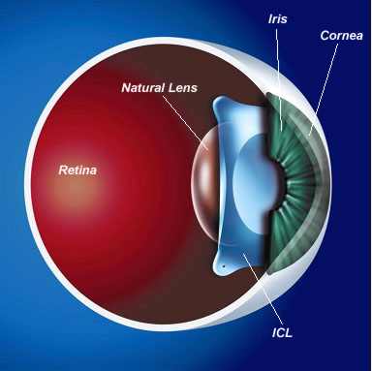
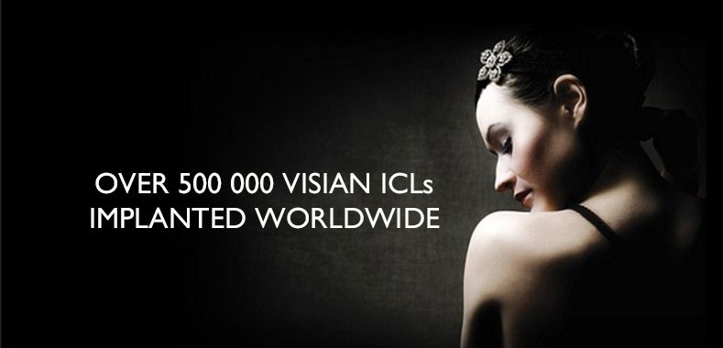
STAAR® SURGICAL IS…
… a Leading Developer, Manufacturer and Marketer of Premium Implantable Lenses for Refractive Vision Correction
Implantable Collamer® Lens or “ICL”™
A Premium Refractive Procedure Delivering Visual Freedom to the Patient
>550,000 Visian® ICLs Implanted
70%
Q3 YTD 2015 Lenses

Slide 4
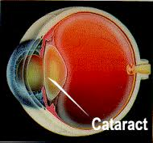
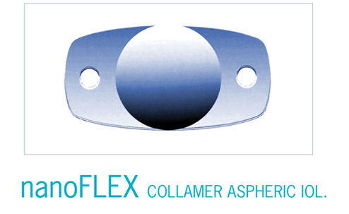
STAAR SURGICAL IS…
… a Developer, Manufacturer and Marketer of Premium Implantable Lenses for Cataract Lens Replacement (Assessing Strategy in 2016)
Intraocular Lens (IOL)
Used to Replace the Natural Lens after Cataract Surgery
30%
Q3 YTD 2015 Lenses

Slide 5

REFRACTIVE MARKET 2017
WW Refractive Market by Region
2014-2017 Growth Rate
Total Procedures 3.3 Million % by Region
Total Procedures 3.9 Million
3-year CAGR = 5.6%
Year 2014
Source: Market Scope
Notes:
5

Slide 6

TOP 10 COUNTRIES – REFRACTIVE PROCEDURES
China 875,000
USA 602,000
India 156,430
South Korea 139,280
Germany 135,000
Japan 125,000
Italy 105,240
Spain 105,000
Brazil 102,580
UK 97,540
Source: Market Scope

Slide 7
STAAR APPROACH TO THE MARKET
2014 Now
Focused on Lenses Inserted into the Eye and Delivery Systems Therefor
Two Large Market Opportunities
Rapid Cadence of New ICL and IOL Products
Focus on Top 12 Markets for ICLs
Selective approach with IOLs in 8 main markets based on market opportunity for premium prices and STAAR business structure
Focused on Lenses Inserted into the Eye with Companion Delivery Systems Delighting Surgeons and Their Patients… the premium and primary choice
Three Large Vision Enhancement Market Opportunities
Build and Brand the Visual Freedom Market
Focus and Effectively Target All Global Markets for ICLs… apply surgeon and patient choice paradigm
Treat Cataract Care Lens Development (IOL) as a Required Vision Choice and Determine Best Approach to Market… with distinct advantages and affordability

Slide 8
STAAR APPROACH TO THE MARKET
2014 Now
Increasing IP Position with New Technologies
Provide sufficient clinical data to HCPs that supports STAAR products
Increasing emphasis on growing the consumer demand for ICLs; expand to presbyopic patients for V6 models
Selective adjustments to business structure based on market opportunity and distributor performance
Materially Strengthen and Expand IP Patent Estate, Continually Secure Trade Secrets
Build Global Clinical Validation, Clinical Utility and Patient Registries as Best in Class
Become a Consumer Facing Company Highlighting the Patient Experience by Patients and for Surgeons… Focus on Visual Freedom for all Ages
Aggressively Develop Global Go-to-Market to Include Direct, Distributor, Centers of Excellence and Corporate Account Partnerships

Slide 9

OUR FOCUS 2015 - 2017
BUILDING A FOUNDATION FOR CONSISTENT GROWTH
Engender Culture of Quality - FDA Remediation and Systemic Change
Build R & D Continuum: CentraFLOW®/ Presbyopia/ Cataract Care
Invest in Proprietary Technology and Process Improvements
Develop Global Clinical Validation and Clinical Utility Competency
Properly Size Commercial Strategic Investment – People and Services
Create an Extraordinary Surgeon and Patient Experience
Deliver Shareholder Value

Slide 10
2016: Continuing Growth & Investment
Growth of the ICL: Expected Double Digit Unit Growth and Expanding Gross Margins
Continuing Investment: 2016 Another Investment Year for STAAR - Phase 2 of 3 Year Plan
FDA Remediation and Continuation of Quality System Overhaul: $3M
Create the Visual Freedom Consumer Market for Implantable Lenses: $2M
Rebranding of STAAR and ICL
Close Large Blocks of Corporate Accounts Business - Agreements Signed 1/1/2016:
Aier Eye Hospital Group, China (60 hospitals with expansion plans to reach 200 hospitals by 2020)
Memira Eye Clinics, Sweden (49 clinics – largest eye surgery group in Scandinavia)

Slide 11
2016: Continuing Growth & Investment
Growth of the ICL: Expected Double Digit Unit Growth and Expanding Gross Margins
Continuing Investment: 2016 Another Investment Year for STAAR – Phase 2 of 3 Year Plan
Establish Centers of Excellence: New Training by and Recognition of World’s Best ICL Surgeons
Begin Clinical Validation – Regulatory Rebirth: Rigorous Clinical Trials with Compelling Data – Retrospective Data on 200,000 CentraFLOW ICL Lenses Implanted Supports Clinical Efficacy and Safety
Innovate and Develop Products, Delivery Systems, Materials: Presbyopic ICL, Next Generation ICL and Delivery Systems, New Collamer®
Continue Infrastructure and Systems Renovation: $4M

Slide 12

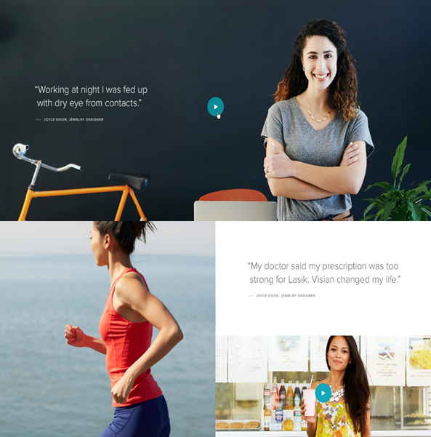
STAAR SURGICAL WAS… 2014
Selling Implantable Lenses as a Procedure for LASIK Rejects… 10% of the Eyes

Slide 13



STAAR SURGICAL IS… 2016
Creating the Visual Freedom Market for Implantable Lenses “ICL”

Slide 14
RECENT FINANCIAL RESULTS
Q3 2015 GAAP ($ millions, except per share)
Income Statement | Q3 2015 | Q3 2014
Revenue | $ 18.8 | $ 18.2
Gross Profit | $ 12.8 | $ 11.9
Gross Profit Margin | 68.3% | 65.3%
Operating Expenses | $ 14.8 | $ 13.4
Other Income (Loss) | $ 0.3 | $ (0.6)
Income (Loss) Before Taxes | $ (1.8) | $ (2.2)
Net Income (Loss) | $ (1.8) | $ (2.7)
Net Inc. (Loss) per Dil. Share | $ (0.04) | $ (0.07)

Slide 15
RECENT FINANCIAL RESULTS
Q3 2015 Non-GAAP ($ millions, except per share)
Adjusted Net Income | Q3 2015 | Q3 2014
Net Income (Loss) | $ (1.8) | $ (2.7)
Foreign Currency Impact | - | $ 0.6
Stock-Based Compensation Expense | $ 0.9 | $ 1.6
Remediation Expense | $ 0.8 | $ 0.6
Adjusted Net Income (Loss) | - | $ 0.1
Adj. Net Income (Loss) Per Dil. Share | - | -

Slide 16
Q3 FINANCIAL HIGHLIGHTS
Sales of $18.8M: +3% from Prior Year and +7% in Constant Currency
ICL units increased 21% WW: +37% in EMEA; +13% in APAC; +10% in NA
Gross Margin Improved 300 bps: 68.3% Compared to Prior Year of 65.3%
Favorable product mix, lower unit costs, and higher avg. selling prices, partially offset by negative impact of weaker euro
Operating Expense Increased 10% from Prior Year
Increase due to reversal of bonus accruals in prior year period
Net Loss of 4 Cents per Share; Adjusted Net Income was Breakeven
Cash of $16.1M with Addition of $750k in 3rd Quarter
Driven by addition of $1.1M cash from operating activities

Slide 17
OUR FOCUS 2015 - 2017
BUILDING A FOUNDATION FOR CONSISTENT GROWTH
Engender Culture of Quality - FDA Remediation and Systemic Change
Build R & D Continuum: CentraFLOW/ Presbyopia/ Cataract Care
Invest in Proprietary Technology and Process Improvements
Develop Global Clinical Validation and Clinical Utility Competency
Properly Size Commercial Strategic Investment – People and Services
Create an Extraordinary Surgeon and Patient Experience
Deliver Shareholder Value

Slide 18
Investor Update
January 11 & 12, 2016
NASDAQ: STAA

