Slide 1

Q1 2012 results
Investor Presentation
May 2, 2012

Slide 2

Safe harbor
All statements in this presentation that are not statements of historical fact are forward-looking statements, including any projections of earnings, revenue, sales, profit margins, cash or other financial items, any statements of the plans, strategies, and objectives of management for future operations, any statements regarding new products, including but not limited to, expectations for success of the ICL or other products in U.S. or international markets, any statements concerning proposed new products and government approval of new products, services or developments, or other future actions of the FDA or other regulators, any statements regarding expectations for the success of our products in the US and the international markets, the outcome of product research and development or any clinical study, any statements regarding future economic conditions or performance, the size of market opportunities statements of belief and any statements of assumptions underlying any of the foregoing. These statements are based on expectations and assumptions as of the date of this presentation and are subject to numerous risks and uncertainties, which could cause actual results to differ materially from those described in the forward-looking statements.
The risks and uncertainties include our limited capital resources and limited access to financing, the broad discretion of the FDA and other regulators in approving any medical device and the inherent uncertainty that new devices will be approved, the likelihood of administrative delays, the risk that our global consolidation plans will not yield the expected savings in taxes or cost of goods or expose us to supply interruptions, the negative effect of global recession on sales of products, especially products like the ICL used in non-reimbursed elective procedures, the challenge of managing our foreign subsidiaries, the risk that research and development efforts will not be successful or may be delayed in delivering for launch, the willingness of surgeons and patients to adopt a new product and procedure, and the potential effect of negative publicity about LASIK on the demand for refractive surgery in general in the U.S., and the other factors discussed under the heading “Risk Factors” in our Annual Report on Form 10-K filed with the SEC on March 8, 2012. STAAR assumes no obligation to update its forward-looking statements to reflect future events or actual outcomes and does not intend to do so.
®

Slide 3
agenda
Q1 Revenue Results Barry G. Caldwell
2012 Key Metric Review Chief Executive Officer
Financial Review Deborah Andrews
Project Comet Update Chief Financial Officer
Recent Meetings Barry G. Caldwell
Technology/New Product Updates Chief Executive Officer
Upcoming Investor Events
Q&A Session Your Questions
®

Slide 4
2012 Q1 Revenues
 | Q1 2012 | Q1 2011 | Improvement
ICL Sales | $ 8,605 | $ 6,897 | +$1,708/+25%
IOL Sales | $ 6,358 | $ 7,120 | ($762)/-11%
Core Product Sales | $14,963 | $14,017 | +$946/+7%
Other | $ 546 | $ 832 | ($286)/-34%
Total Sales | $15,509 | $14,849 | +$660/+4.4%
®

Slide 5


2011 Key Metric Report Card Increased 3 of 4 Metrics Mid-Year
 | Q1 | Q2 | Q3 | Q4 | 2011
Double Digit Revenue Growth
Grow ICL Sales by 25%, 30%
Continuous Expansion of GM %, End year at 66%, 66.5%
Profitable in 3 of 4 all 4 quarters and for the full year
®

Slide 6
2012 Key Metric Report Card
 | Q1 | Q2 | Q3 | Q4 | 2012
Increase revenues by 15%
Exceed 2011 Visian ICL sales growth of 32%
Continuous expansion of GM % to achieve 71% for the full year
Profitable each quarter and full year
Successfully implement Comet without disruption of product supply
®

Slide 7
Visian ICL Revenue Gains Increase of 25% in Q1 2012 and 32% in 2011
Millions $
®

Slide 8
APAC and top 11 targeted markets 2012 Q1 Results
+30%
+50%
®

Slide 9
Key icl Asia pacific markets 2012 Q1 Results
+37%
+110%
+93%
+47%
®

Slide 10
EMEA and NA ICL q1 results
EMEA growth was at 2% (unusually low rate)
During March 2011 we introduced the V4b and stocking distributors ordered the new ranges.
WOC held in February reduced refractive procedures overall particularly in Mideast. Meeting not held in 2011.
Two fairly large orders held at quarter end due to import regulations and payment limitations.
58% of all ICLs were V4c during the quarter.
Over 1,000 implanted and AquaPORT worked every time.
NA growth was 4%
U.S. civilian sales increased by 6% while military sales decreased by 34%. Military 8% of total U.S. ICL sales.
®

Slide 11
Q1 2012 IOL Results
IOL sales declined 11% or $762k during the quarter.
During Q1/11 we sold IOL inventory to new distributor, this accounts for half of the total decline.
IOL sales in Japan declined 7% or $221k.
Very aggressive competitive pricing during the quarter.
Japan IOL sales have increased 6% during April.
Decrease of IOL sales in low end silicon segment in U.S. were not offset by gains in nanoFLEX and Toric IOLs.
®

Slide 12
Overall Q1 start to 2012
25% ICL growth rate is healthy start. Q1 2011 was only 18% when we posted a 32% for the year.
Slower start with our IOL sales, but with new products and the comparatives for the remainder of year we see growth returning.
We reiterate our confidence in achieving our 2012 Key Metrics for the full year.
Key progress made during the quarter will help drive performance for the remainder of year.
®

Slide 13
Financial review manufacturing consolidation update
Deborah Andrews
Chief Financial Officer
®

Slide 14
2012 Q1 GAAP Results Comparison to Q1 2011 ($000’s)
 | Q1 2012 | Q1 2011 | Improvement
Revenue | $15,509 | $14,849 | +$660/+4.4%
Gross Profit Dollars | $10,902 | $ 9,629 | +$1,273/+13%
Gross Profit Margin | 70.3% | 64.8% | +550bps
Operating Exps ex Comet | $10,069 | $ 9,288 | +$781/+8%
Operating Expenses | $10,624 | $ 9,421 | +$1,203/+13%
Operating Income | $ 278 | $ 208 | +$ 70/+34%
Other Income | $ 186 | $ 395 | ($ 209)
Income Taxes | $ 232 | $ 303 | ($ 71)
Net Income | $ 232 | $ 300 | ($ 68)
®
Notes:
7,971

Slide 15

Expanding Gross Margins With ICL Product Mix Gains
Gross margins have expanded from 49% to 70.3%.
Q1 Mix: ICLs at 55.5% and IOLs at 41%.
®

Slide 16
Reconciliation of non-gaap measure
Measure | Q1 2012 | Q1 2011
GAAP net income | $ 232 | $ 300
Mfg consolidation expenses | $ 555 | $ 133
Gain foreign currency | ($ 67) | ($ 372)
Adjustment of warrant value | $ 14 | ($ 103)
Stock-based compensation expense | $ 687 | $ 355
Adjusted net income | $1,421 | $ 313
Adjusted income per share | $ 0.04 | $ 0.01
®
Notes:
7,971

Slide 17
Cash
 | Q1 2012 | Q1 2011
Net income | $ 232 | $ 300
Non-cash | $ 1,362 | $ 765
Working capital | ($ 2,031) | ($ 515)
Cash (used in) provided by operations | ($ 437) | $ 550
Cash (used in) provided by investing activities | ($ 158) | $ 30
Cash provided by financing activities | $ 642 | $ 475
Exchange | ($ 184) | ($ 219)
(Decrease) increase in cash | ($ 137) | $ 836
Cash, at beginning of period | $16,582 | $ 9,376
Cash, at end of period | $16,445 | $10,212
®
Notes:
7,971

Slide 18
Project comet Update manufacturing consolidation
Q1 2012 Expenses
Expenses for the quarter were $555k.
Total expense for the year $2M to $2.5M.
Progress during the quarter.
Project teams with detailed schedules for each move
Received the regulatory approval three months earlier than expected to ship preloaded IOLs from the U.S. to Japan.
Making facility modifications to Monrovia plant.
Capital purchases well underway.
Expect to be shipping all Preloaded IOLs to Japan from U.S. during the third quarter of 2012.
Expect to be shipping first Visian ICLs OUS from U.S. during the first quarter of 2013.
®

Slide 19
Recent conference successes technology updates upcoming investor events
Barry G. Caldwell
Chief Executive Officer
®

Slide 20
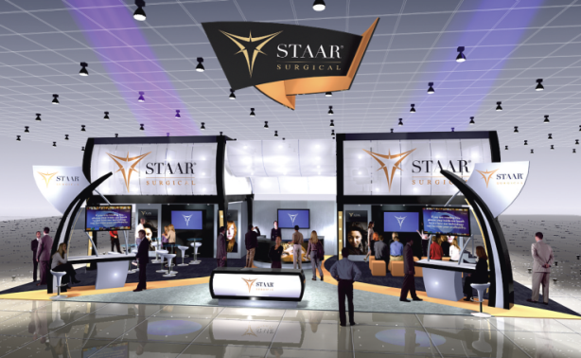
Q1 Key ophthalmic conferences
Significantly increased presence at major meetings
World Ophthalmology Conference in Abu Dhabi
First Mideast ICL Experts Meeting
Revolutions in Refractive Surgery Symposium
16 presentations on Visian ICL
American Society of Cataract & Refractive Surgeons
Welcome reception for over 200 customers
33 presentations on the Visian ICL
Investor breakfast featuring Dr. Baikoff from France
®

Slide 21
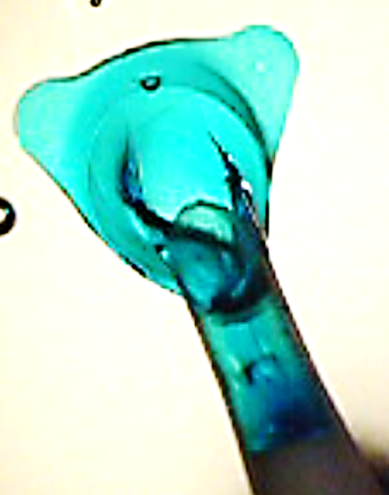
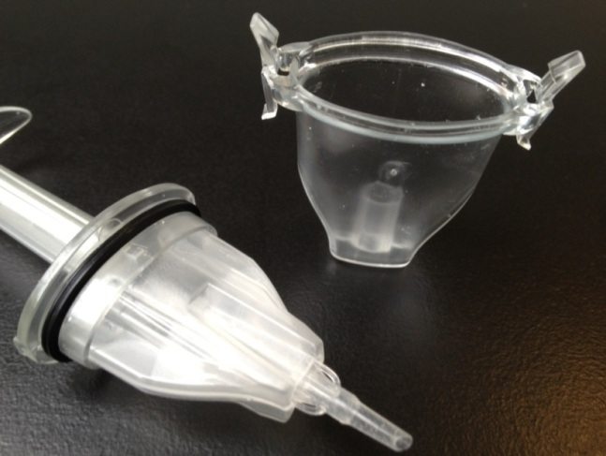
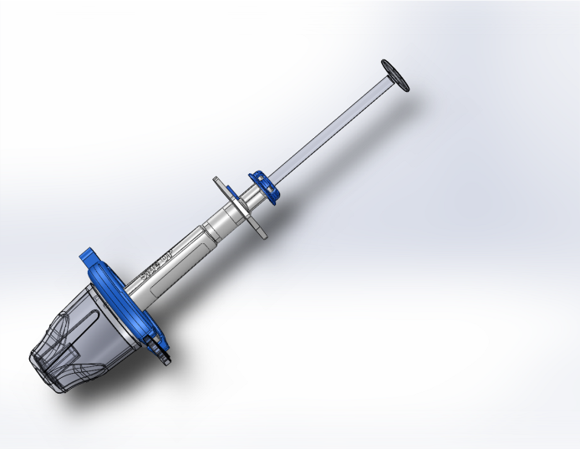

Q1 Technology Updates
Inventions completed during the quarter allowing Collamer lens to be sterilized in preloaded system.
Key feature on the Visian V5 ICL
Key surgeons evaluated during ASCRS meeting with very good feedback
Believe same system can be used to preload nanoFLEX IOLs
®

Slide 22
Q1 Technology updates
nanoFLEX Toric IOL
We had planned to start implanting this new IOL during Q1-it is now planned for Q2
This will allow us to open more markets in Europe to the nanoFLEX IOL as well
KS-SP Single Piece Preloaded Acrylic IOL
This is an important IOL for Japan and Europe
We were having issues with consistent delivery of the IOL into the eye.
During the quarter our engineering team in Japan resolved the issues and we can now move to manufacturing these lenses for commercialization
®

Slide 23
2012 Key metrics
Increase revenues by 15%.
Exceed 2011 ICL growth rate of 32%.
Continuous expansion of gross margin and achieve 71% for the full year.
Profitable each quarter and the full year.
Successfully implement mfg. consolidation without disruption to customer service levels and quality
®

Slide 24
Upcoming Investor events
Deutsche Bank Healthcare Conference
May 8th Boston
Annual Shareholders Meeting
May 14th Monrovia, California
13th Annual B. Riley Investor Conference
May 23rd Santa Monica, California
Benchmark One on One Conference
May 31st Milwaukee
Jefferies Global Healthcare Conference
June 7th New York City
Canaccord NDRS
June 27th in Zurich
®

Slide 25
Thank you!
YOUR QUESTIONS PLEASE
®

